Slide 1

Simulated IoT Sensor Network with Role-Based Access Control Using ThingsBoard & Python
Final Project – CIS 5370
Group 9
04/24/2025

Slide 2
Group 9
Christopher Meadows - 3289481
Shree Majumder – 6240191
Fares Amamou - 6209574
Course: CIS 5370
Semester Spring 2025
Florida International University

Slide 3
Agenda
Project Overview & Objectives
Background & Literature Review
System Architecture & Methodology
Demonstration of RBAC Enforcement
Experimental Results
Conclusions
Future Work
References

Slide 4

Project Overview
Goal: Simulate a secure environmental-monitoring IoT network.
Platform: ThingsBoard Community Edition (open-source).
Security Model: Role-Based Access Control (RBAC).
Devices: Python-simulated Temperature & CO₂ sensors publishing via MQTT.
Roles Tested:
Administrator – full control
Operator – monitor devices & telemetry
Viewer – read-only; no explicit device assignment

Slide 5

Why Access Control Matters in IoT
Exponential growth of connected devices ⇒ broader attack surface.
Sensitive telemetry (e.g., environmental data in smart cities) demands privacy & integrity.
RBAC offers least-privilege access, simpler administration, and clear audit trails.

Slide 6
Literature Review (1/2) – Access Control Models
Model | Pros | Cons | Key Works
RBAC | Intuitive role hierarchy, low admin overhead | Coarse-grained | Sandhu et al., 1996
ABAC | Context-aware, fine-grained | Policy complexity | Kumar et al., 2020
Selected RBAC for its clarity, lower overhead, and native support in ThingsBoard.

Slide 7
Literature Review (2/2) – IoT Platforms
Feature | ThingsBoard | AWS IoT Core | Azure IoT Hub
Open Source | Yes | No | No
Cost | Free (Community) | Pay-per-use | Pay-per-use
Access Control | Built-in RBAC | IAM Policies (ABAC) | Role-based + ABAC
MQTT/REST Support | Yes | Yes | Yes
Educational Usability | High | Moderate | Moderate
ThingsBoard chosen for no-cost licensing, community support, and comprehensive RBAC.

Slide 8
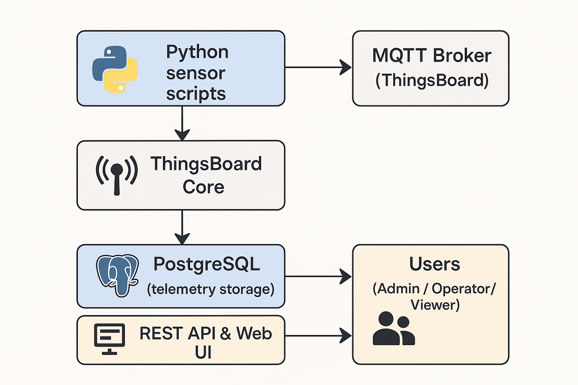
System Architecture
TLS is enabled for MQTT & HTTPS channels.

Slide 9
User & Device Provisioning
User | Role | Customer Scope | Key Permissions
Alice | Tenant Admin | All | Configure, manage, view
Bob | Operator | Customer A | View dashboards & telemetry
Charlie | Viewer | Customer B | Authenticate only (no devices)
Each virtual device has a unique token; customer mapping replicates real tenancy.

Slide 10
Sensor Simulation Scripts
simulation_temp_sensor2.py
Random °C values (20 – 35) every 5 s.
simulation_CO2_sensor.py
Random ppm values (400 – 1 000) every 5 s.
Both publish JSON payloads to /v1/devices/me/telemetry via MQTT.

Slide 11

RBAC Evaluation Workflow
main.py (test harness)
Authenticate each user → obtain JWT.
Query visible devices (/api/customerDevices).
Fetch timeseries telemetry via REST & token API.
Log success / failure for every call.
Generates admin_log.txt, operator_log.txt, viewer_log.txt.

Slide 12

Dashboards by Role
Dashboard Screenshots: Each role’s view of the dashboard
Alice (Admin) view
Bob (Operator) view
Charlie (Viewer) view

Slide 13
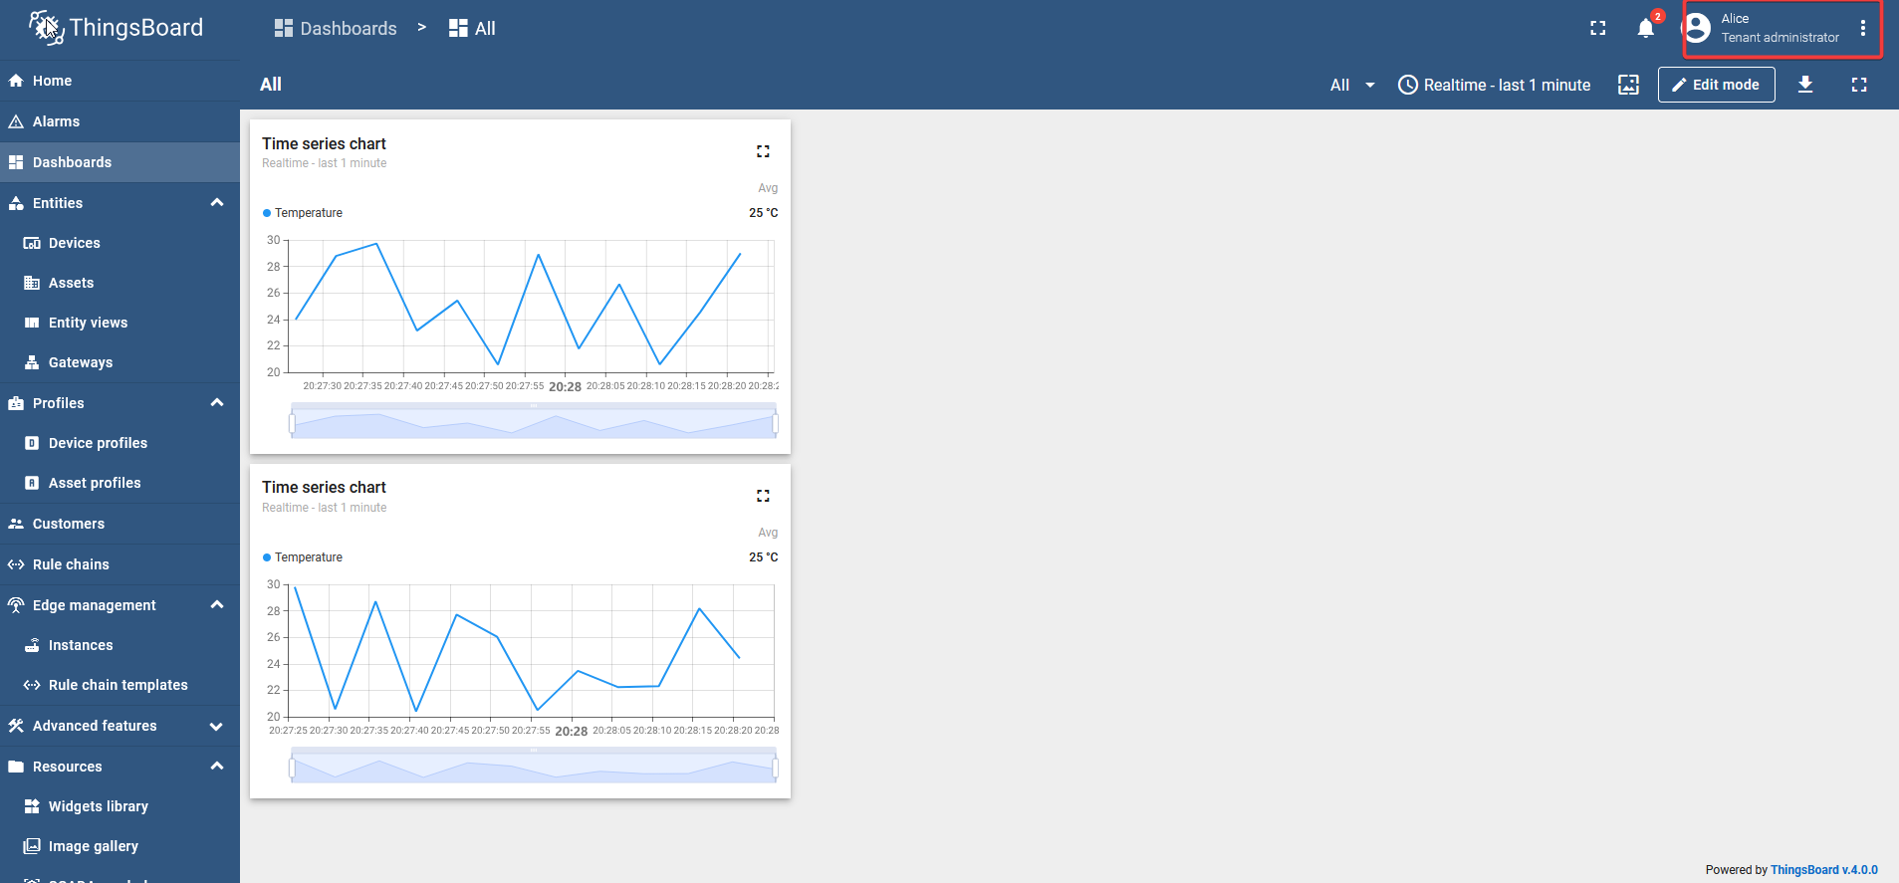
Alice (Admin) View

Slide 14
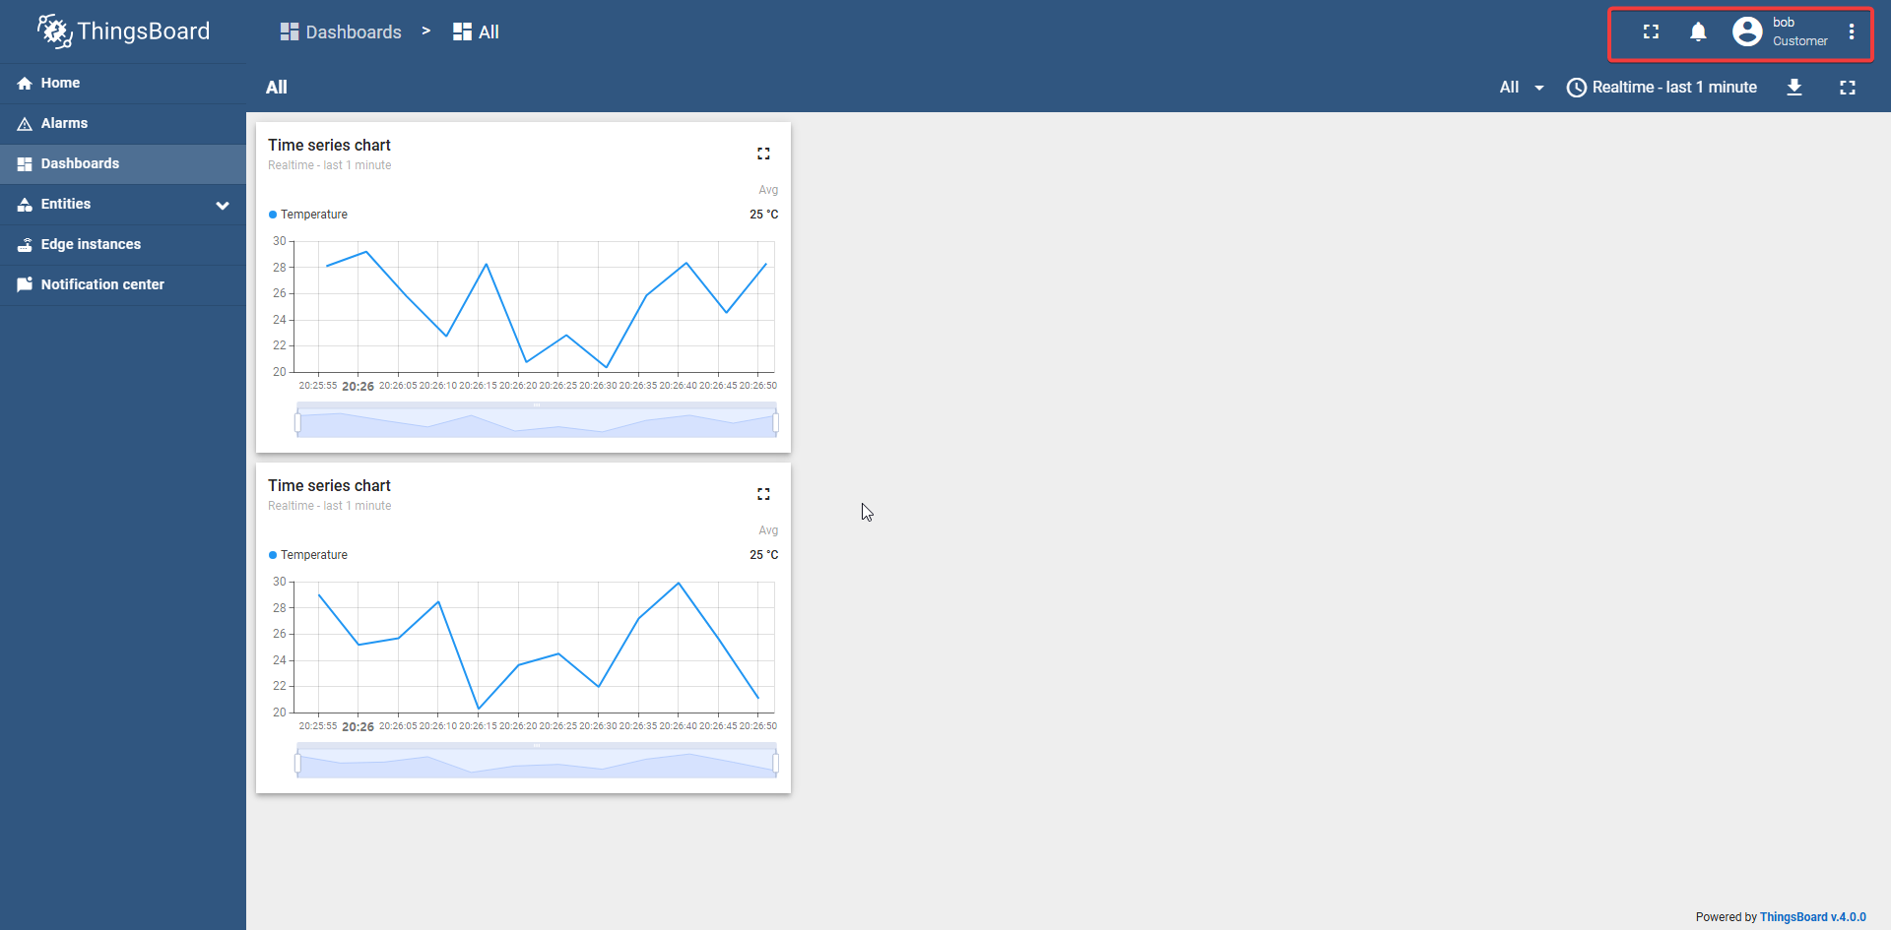
Bob (Operator) View

Slide 15
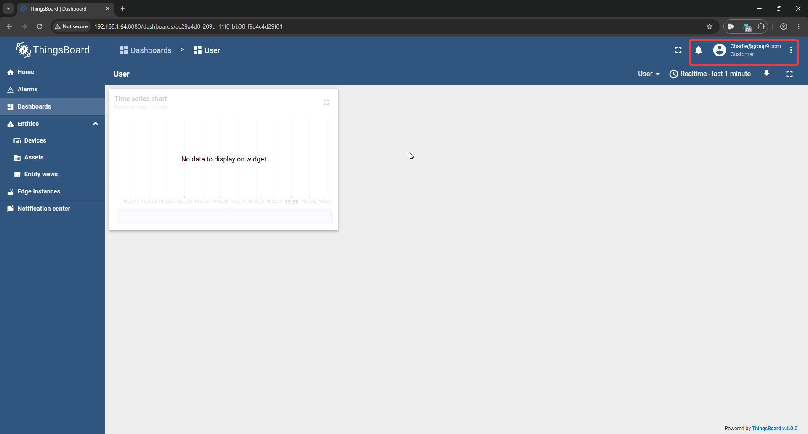
Charlie (Viewer) View

Slide 16
Test Matrix
Action | Admin | Operator | Viewer
REST Login | ✔ | ✔ | ✔
List Devices | ✔ | ✔ | ✖
Read Telemetry | ✔ | ✔ | ✖
Modify Dashboards | ✔ | ✖ | ✖
Access Device Tokens | ✔ | ✖ | ✖
RBAC policies correctly enforced; zero unauthorized data leaks.

Slide 17
Observations per Role
Alice (Admin): Full visibility; can create users, dashboards, device creds.
Bob (Operator): Read-only access to Customer A devices; config actions blocked.
Charlie (Viewer): Auth succeeds, but zero resources visible—demonstrating denial by default.

Slide 18
Key Findings
ThingsBoard’s native RBAC reliably enforces hierarchical permissions.
Token-based telemetry endpoints respect user-device assignments.
Open-source stack (Python + ThingsBoard) enables low-cost security prototyping.

Slide 19

Limitations
Software-only simulation: no physical sensors.
Static roles: lacks context-aware policies (time, location).
Basic alerts: no automated response to threshold breaches.

Slide 20
Future Work
Integrate real hardware (Raspberry Pi, air-quality modules).
Add blockchain-backed audit logs for tamper-proof records.
Implement dynamic ABAC overlays (contextual policies).
Build notification rules (email/SMS) for sensor thresholds.

Slide 21
Conclusion
Demonstrated a secure, role-segmented IoT environment.
Validated that least-privilege principles prevent data over-exposure.
Provided an educational blueprint for low-cost IoT security labs.

Slide 22

References
Sandhu R. et al., “Role-Based Access Control Models,” IEEE Computer, 1996.
Zhang L. et al., “RBAC in Smart City IoT,” Journal of IoT Security, 2021.
Alshahrani A., Hussain F., “Security & Privacy in IoT,” IEEE Access, 2020.
O’Neill M., Cullen C., “Evaluating Open-Source IoT Platforms,” IoT Security Conf., 2019.

Slide 23
Appendix / Resources
API Swagger: https://demo.thingsboard.io/swagger-ui
Install Guide (Ubuntu): thingsboard.io/docs/user-guide/install/ubuntu
RBAC Docs: thingsboard.io/docs/pe/user-guide/rbac
Source Code: github.com/fares1121/IoT-RBAC-Simulation

Slide 24

Thank You

